Slide 1

Starkey Laboratories
Holly Wanous
11/02/2025

Slide 2



agenda
Based on LCCA needs
Communication
Content
Regulatory
Technology
Additional topics
Revise and new
courses – 2025
Comp Checks
Connecting courses
MDS changes
Needs assessment 2026
Zoom
Moving forward
Getting ahead of regulation
Timeline
New LMS roll out
Legal
Paisley Park

Slide 3
Updated
Courses remaining
01
Cardiovascular Disease and Mobility: Disease Process
08
Home Care: Bill of Rights
02
Cardiovascular Disease and Mobility: The Heart
09
Hospice Care in the Long-Term Care Setting
03
Cardiovascular Disease and Mobility: Effects of Therapy
10
Improving Functional Performance of Medically Complex Persons
04
Care of the Individual with a Tracheostomy
11
Rehabilitation Consideration for People with Neurodegenerative Diseases
05
Emerging Disease: Monkeypox
06
Fecal and Urinary Incontinence Basics: CNA
12
Rehabilitation: Parkinson’s and Related Diseases
07
Fecal and Urinary Incontinence Overview (ALF and SNF)
13
Rehabilitative Care

Slide 4


Content
The First 100% Digital Competency Tool
Evaluate in real-time
100% digital platform allows you to document live observation of skills.
New-hire
orientation
Automatic
documentation
Skills
fair
Use evidence-based checklist
Designed by industry experts to develop competent and confident staff.
Train and
remediate at
individual level
Consistent and standardized
Delivers efficiency by training consistent skills across learners. Evaluators use standardized assessments for all.

Slide 5

Promo Video Time

Slide 6


Slide 7

…and advance to
next slide

Slide 8

Regulatory
GOAL
Do this by:
  Focus on LCCA states
  AHCA resources
  Research
  Communication
    Speaking & Listening
Learn about anticipated regulations by state

Slide 9
Regulatory
GOAL
Do this by:
  Focus on LCCA states
  AHCA resources
  Research
  Communication
    Speaking & Listening
Learn about anticipated regulations by state

Slide 10
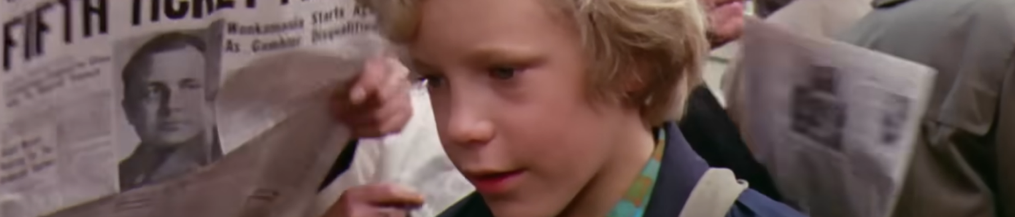
Charlie
Here Comes
  The house wasn’t nearly large enough for so many people, and life was extremely uncomfortable for them all. There were only two rooms in the place altogether, and there was only one bed. The bed was given to the four old grandparents because they were so old and tired. They were so tired, they never got out of it.
  Grandpa Joe and Grandma Josephine on this side, Grandpa George and Grandma Georgina on this side.
  Mr and Mrs Bucket and little Charlie Bucket slept in the other room, upon mattresses on the floor.
  In the summertime, this wasn’t too bad, but in the winter, freezing cold draughts blew across the floor all night long, and it was awful.
  There wasn’t any question of them being able to buy a better house — or even one more bed to sleep in. They were far too poor for that.
  Mr Bucket was the only person in the family with a job. He worked in a toothpaste factory, where he sat all day long at a bench and screwed the little caps on to the tops of the tubes of toothpaste after the tubes had been filled. But a toothpaste cap-screwer is never paid very much money, and poor Mr Bucket, , however hard he worked, and however fast he screwed on the caps, was never able to make enough to buy one half of the things that so large a family needed. There wasn’t even enough money to buy proper food for them all. The only meals they could afford were bread and margarine for breakfast, boiled potatoes and cabbage for lunch, and cabbage soup for supper. Sundays were a bit better. They all looked forward to Sundays because then, although they had exactly the same, everyone was allowed a second helping.
  The Buckets, of course, didn’t starve, but every one of them – the two old grandfathers, the two old grandmothers, Charlie’s father, Charlie’s mother, and especially little Charlie himself – went about from morning till night with a horrible empty feeling in their tummies.
  Charlie felt it worst of all. And although his father and mother often went without their own share of lunch or supper so that they could give it to him, it still wasn’t nearly enough for a growing boy. He desperately wanted something more filling and satisfying than cabbage and cabbage soup. The one thing he longed for more than anything else was . . . CHOCOLATE.

Slide 11

Summary & Next Steps

Slide 12
You!
Thank

